Slide 1
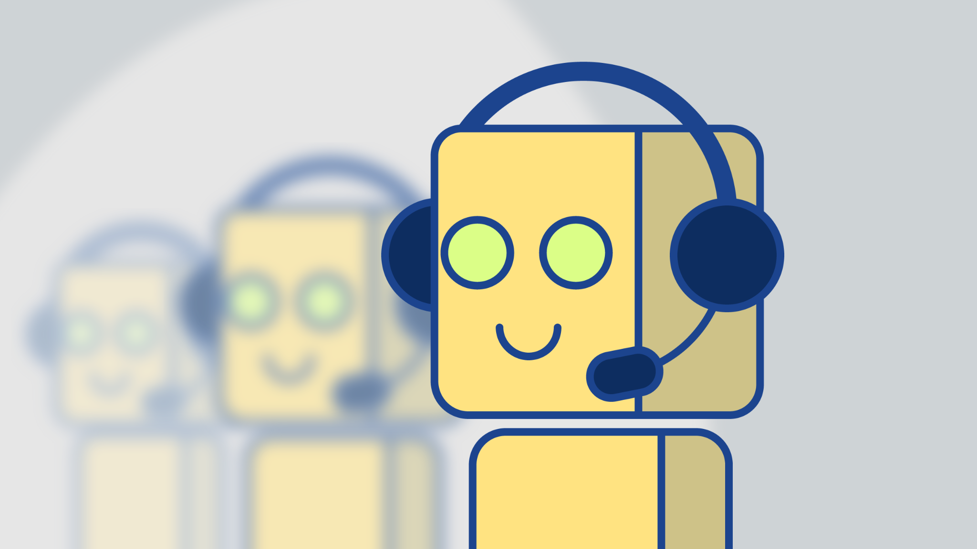
Price Negotiator Ecommerce Chatbot System for a movie subscription website Movieflix.
By - Krishna Bakshi
(100804293)

Slide 2
Overview
Building a Price Negotiator Ecommerce Chatbot that uses AI to negotiate subscription prices with MovieFlix consumers.
How it works ?
When browsing the MovieFlix website customers can negotiate subscription prices with the chatbot, Ask questions about the plans and other basic questions and other questions that the chatbot can answer for them.

Slide 3
MovieFlix Chabot
Built the chatbot agent for MovieFlix using Google's Dialog Flow framework that uses NLP to train the model/chatbot.
First we specify the intents that would the questions a customer may ask the chatbot. Then was add responses to these intents, We added sub-intents or follow up intents based on the replies we get from customers.
Website Link - https://kbakshi15.wixsite.com/my-site

Slide 4
Thank You.

